Slide 1


VidGenie: Revolutionizing Educational Content
Welcome to the future of educational content creation. VidGenie is an AI-powered platform that leverages the power of Retrieval-Augmented Generation (RAG) technology to transform video content into essential instructional materials. This innovative solution empowers educators, instructors, and content creators to produce high-quality syllabi, study guides, and slide presentations efficiently and effectively.

Slide 2
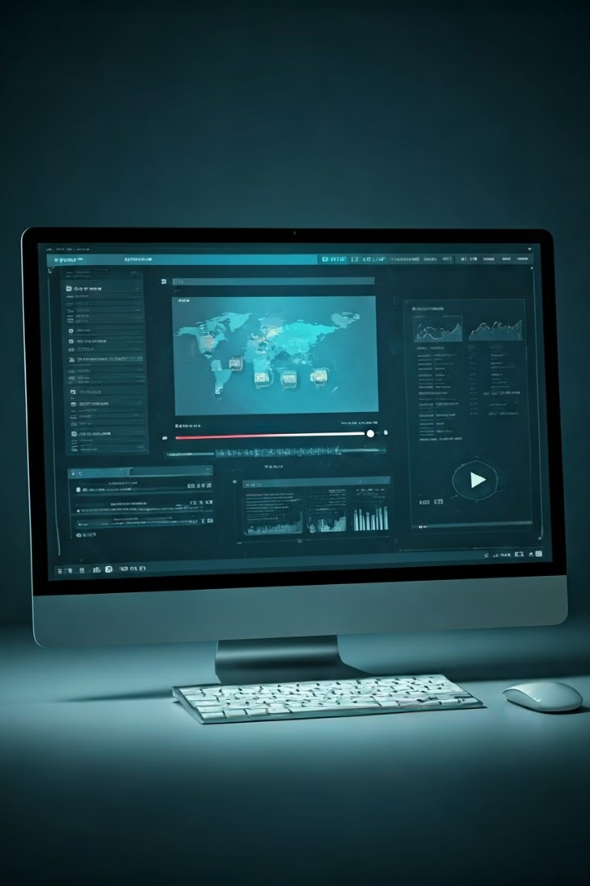
Intelligent Video Analysis
Computer Vision
VidGenie utilizes cutting-edge computer vision algorithms to analyze video content, identifying key visual elements, objects, and scenes. This deep understanding of the video's visual content forms the foundation for generating rich and informative supporting materials.
Machine Learning
Machine learning models are employed to extract relevant topics, themes, and concepts from the video content. This process goes beyond simple keyword identification, capturing the underlying meaning and structure of the video to create accurate and comprehensive materials.
Semantic Analysis
By analyzing the video's semantic content, VidGenie understands the relationships between concepts, keywords, and themes. This allows for the generation of organized and coherent supporting materials that facilitate deep understanding and knowledge retention.

Slide 3
Generating Instructional Materials
Syllabi
Study Guides
Slide Presentations
VidGenie automatically generates structured syllabi that outline key concepts, learning objectives, and assessment criteria. This helps educators save time and create a clear roadmap for their students.
Detailed study guides are created, providing learners with step-by-step guidance to understand and apply concepts covered in the video. These guides enhance comprehension and provide a framework for active learning.
VidGenie generates visually appealing and informative slide presentations that summarize key points, include relevant images, and incorporate diagrams. These presentations help learners engage with the content and retain information more effectively.

Slide 4

Customization for Every Need
1
Topic Selection
2
Detail Level
3
Format Flexibility
Users have the flexibility to choose specific topics or sections within the video they want to focus on. This allows for targeted learning and tailored materials.
Users can adjust the level of detail for the generated materials, ensuring appropriate complexity for different audiences and learning goals. This customization allows for a personalized learning experience.
VidGenie offers various output formats, including PDF, PowerPoint, and Google Slides. This allows users to choose the format that best suits their needs and existing workflows.

Slide 5




Seamless Integration & Collaboration
LMS Integration
Video Platform Integration
Collaborative Workspaces
VidGenie seamlessly integrates with popular Learning Management Systems (LMS) such as Canvas and Moodle. This allows educators to easily incorporate generated materials into their existing courses and workflows.
VidGenie integrates with prominent video platforms like YouTube and Vimeo. This enables educators to analyze and generate materials from content already available online, streamlining the process.
VidGenie facilitates collaboration by allowing multiple users to work together on generating and customizing materials. This fosters teamwork and promotes peer review, leading to enhanced quality and comprehensive resources.

Slide 6




Revolutionizing Educational Outcomes
Time-Saving Efficiency
Improved Accessibility
Enhanced Learning Outcomes
VidGenie automates the creation of instructional supporting materials, freeing up educators' valuable time to focus on teaching, research, and other essential tasks. This leads to increased productivity and improved work-life balance.
By offering various output formats and customization options, VidGenie ensures that learners with diverse learning styles and abilities can access and engage with the content effectively. This promotes inclusivity and removes barriers to learning.
VidGenie provides structured and organized materials that improve learners' understanding and retention of video content. This leads to higher engagement, deeper learning, and improved academic performance.

Slide 7
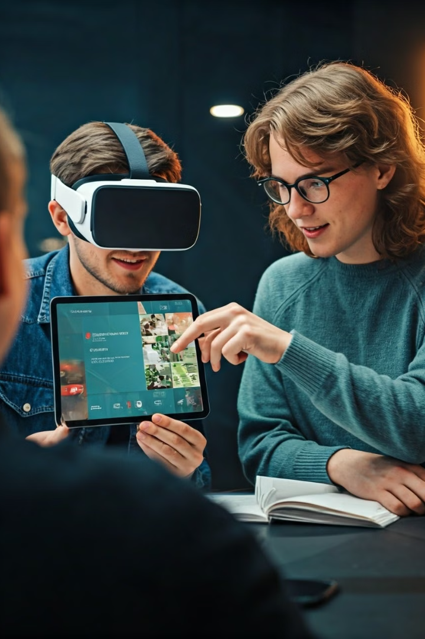
Unlocking New Possibilities
Future Development
Description
Multimodal Input
Expand to support audio and text input for generating more comprehensive supporting materials.
NLP Integration
Integrate Natural Language Processing (NLP) capabilities for more accurate and relevant content generation.
Gamification
Incorporate gamification elements to enhance the learning experience and make it more engaging and interactive.

Slide 8
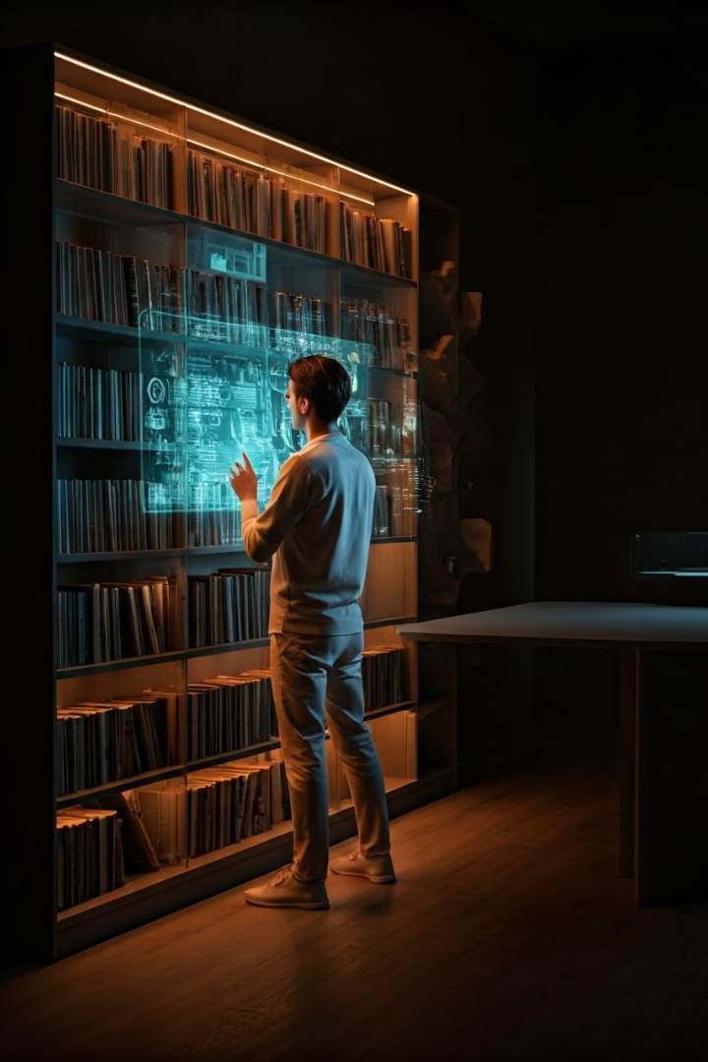
Keeping Learning Up-to-Date
1
Real-Time Updates
VidGenie allows educators to quickly generate updated supporting materials by re-processing video content, ensuring learners have access to the latest information and concepts.
2
Dynamic Content
Incorporate dynamic content, such as current events, news, or research findings, into generated materials to keep them fresh and relevant.
3
Automated Updates
Automatically update generated materials when new video content is added or updated, ensuring learners always have access to the latest information.
4
Personalized Learning
Generate materials based on individual learners' needs and preferences, ensuring they receive the most relevant and up-to-date information.

